Slide 1
Ch 5 – Concurrency
NEU 2017
Notes:
Section references are for the 8th edition of the text

Slide 2
Concurrency (Multiple Contexts)
Multiple Applications
invented to allow processing time to be shared among active applications
Structured Applications
extension of modular design and structured programming
Operating System Structure
OS themselves implemented as a set of processes or threads
Notes:
Fundamental to all of these areas, and fundamental to OS design, is concurrency. Concurrency encompasses a host of design issues, including communication among processes, sharing of and competing for resources (such as memory, files, and I/O access), synchronization of the activities of multiple processes, and allocation of processor time to processes. We shall see that these issues arise not just in multiprocessing and distributed processing environments but even in single-processor multiprogramming systems.
Concurrency arises in three different contexts:
• Multiple applications: Multiprogramming was invented to allow processing time to be dynamically shared among a number of active applications.
• Structured applications: As an extension of the principles of modular design and structured programming, some applications can be effectively programmed as a set of concurrent processes.
Operating system structure: The same structuring advantages apply to systems programs, and we have seen that operating systems are themselves often implemented as a set of processes or threads.

Slide 3
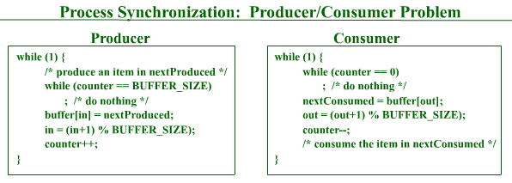
The Challenge …
Shared Resources

Slide 4
Key Terms
Atomic Operation
Indivisible – guarantees isolation from concurrent processes
Critical Section
Accessing shared resources where other processes should not interfere
Deadlock
Processes cannot proceed due to waiting on one another
Livelock
Processes continually change states in response to other processes, preventing any useful work

Slide 5
Key Terms
Mutual Exclusion
Requirement that when one process is accessing a critical section, no other process may do so
Race Condition
Multiple processes reading/writing a shared data item where the final condition depends on the order of execution
Starvation
A runnable process is overlooked indefinitely

Slide 6

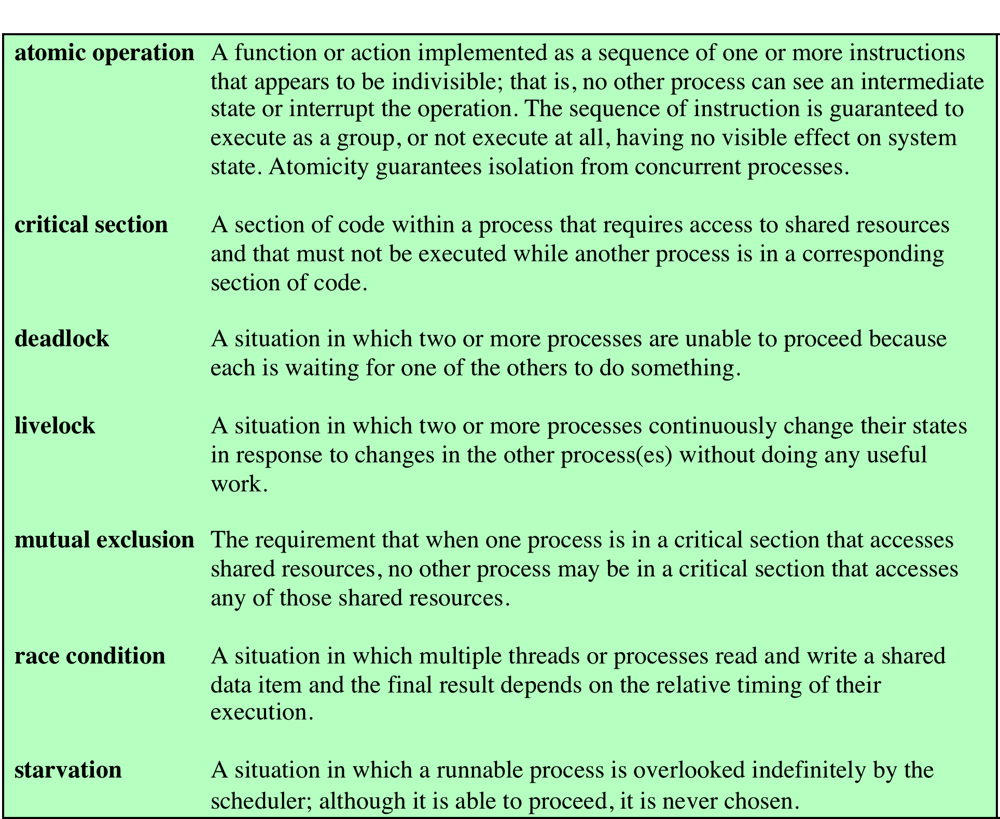
Table 5.1
Some Key Terms Related
to Concurrency
Notes:
Table 5.1 lists some key terms
related to concurrency. A set of animations that illustrate concepts in this chapter is
available online. Click on the rotating globe at this book’s Web site at WilliamStallings.
com/OS/OS7e.html for access.

Slide 7
Mutual Exclusion
Hardware Support
Uniprocessor interrupt disabling
Multiprocessor…

Slide 8
Mutual Exclusion: Hardware Support
Compare & Swap Instruction
also called a “compare and exchange instruction”
a compare is made between a memory value and a test value
if the values are the same a swap occurs
carried out atomically
Notes:
This version of the instruction checks a memory location ( *word ) against a test value ( testval ). If the memory location’s current value is testval, it is replaced with newval ; otherwise it is left unchanged. The old memory value is always returned; thus, the memory location has been updated if the returned value is the same as the test value. This atomic instruction therefore has two parts: A compare is made between a memory value and a test value; if the values are the same, a swap occurs. The entire compare&swap function is carried out atomically—that is, it is not subject to interruption.
Another version of this instruction returns a Boolean value: true if the swap occurred; false otherwise. Some version of this instruction is available on nearly all processor families (x86, IA64, sparc, IBM z series, etc.), and most operating systems use this instruction for support of concurrency.

Slide 9
Figure 5.2
Hardware Support for Mutual Exclusion
(a) Compare and swap instruction (b) Exchange instruction
Notes:
Figure 5.2a shows a mutual exclusion protocol based on the use of this instruction. A shared variable bolt is initialized to 0. The only process that may enter its critical section is one that finds bolt equal to 0. All other processes attempting to enter their critical section go into a busy waiting mode. The term busy waiting , or spin waiting , refers to a technique in which a process can do nothing until it gets permission to enter its critical section but continues to execute an instruction or set of instructions that tests the appropriate variable to gain entrance. When a process leaves its critical section, it resets bolt to 0; at this point one and only one of the waiting processes is granted access to its critical section. The choice of process depends on which process happens to execute the compare & swap instruction next.
Figure 5.2b shows a mutual exclusion protocol based on the use of an exchange instruction. A shared variable bolt is initialized to 0. Each process uses a local variable key that is initialized to 1. The only process that may enter its critical section is one that finds bolt equal to 0. It excludes all other processes from the critical section by setting bolt to 1. When a process leaves its critical section, it resets bolt to 0, allowing another process to gain access to its critical section.

Slide 10
Special Machine Instruction: Advantages
Applicable to any number of processes on either a single processor or multiple processors sharing main memory
Simple and easy to verify
It can be used to support multiple critical sections; each critical section can be defined by its own variable
Notes:
The use of a special machine instruction to enforce mutual exclusion has a number of advantages:
• It is applicable to any number of processes on either a single processor or multiple processors sharing main memory.
• It is simple and therefore easy to verify.
• It can be used to support multiple critical sections; each critical section can be defined by its own variable.

Slide 11
Special Machine Instruction: Disadvantages
Busy-waiting is employed, thus while a process is waiting for access to a critical section it continues to consume processor time
Starvation is possible when a process leaves a critical section and more than one process is waiting
Deadlock is possible
Notes:
There are some serious disadvantages:
• Busy waiting is employed: Thus, while a process is waiting for access to a critical section, it continues to consume processor time.
Starvation is possible: When a process leaves a critical section and more than one process is waiting, the selection of a waiting process is arbitrary. Thus, some process could indefinitely be denied access.
•
Deadlock is possible: Consider the following scenario on a single-processor system. Process P1 executes the special instruction (e.g., compare & swap, exchange ) and enters its critical section. P1 is then interrupted to give the processor to P2, which has higher priority. If P2 now attempts to use the same resource as P1, it will be denied access because of the mutual exclusion mechanism. Thus, it will go into a busy waiting loop. However, P1 will never be dispatched because it is of lower priority than another ready process, P2.
Because of the drawbacks of both the software and hardware solutions just outlined, we need to look for other mechanisms.

Slide 12
Semaphore
A variable that has an integer value upon which only three operations are defined:
There is no way to inspect or manipulate semaphores other than these three operations
May be initialized to a nonnegative integer value
The semWait operation decrements the value
The semSignal operation increments the value
Notes:
The fundamental principle is this: Two or more processes can cooperate by means of simple signals, such that a process can be forced to stop at a specified place until it has received a specific signal. Any complex coordination requirement can be satisfied by the appropriate structure of signals. For signaling, special variables called semaphores are used. To transmit a signal via semaphore s , a process executes the primitive semSignal(s) . To receive a signal via semaphore s , a process executes the primitive semWait(s) ; if the corresponding signal has not yet been transmitted, the process is suspended until the transmission takes place.
To achieve the desired effect, we can view the semaphore as a variable that has an integer value upon which only three operations are defined:
1. A semaphore may be initialized to a nonnegative integer value.
2. The semWait operation decrements the semaphore value. If the value becomes negative, then the process executing the semWait is blocked.
Otherwise, the process continues execution.
3. The semSignal operation increments the semaphore value. If the resulting value is less than or equal to zero, then a process blocked by a semWait operation, if any, is unblocked. Other than these three operations, there is no way to inspect or manipulate semaphores.
We explain these operations as follows. To begin, the semaphore has a zero or positive value. If the value is positive, that value equals the number of processes that can issue a wait and immediately continue to execute. If the value is zero, either by initialization or because a number of processes equal to the initial semaphore value have issued a wait, the next process to issue a wait is blocked, and the semaphore value goes negative. Each subsequent wait drives the semaphore value further into minus territory. The negative value equals the number of processes waiting to be unblocked. Each signal unblocks one of the waiting processes when the semaphore value is negative.

Slide 13
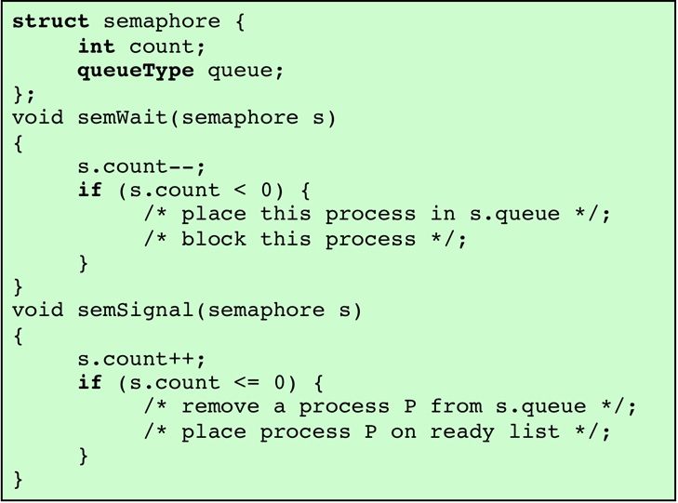
General Semaphore
Figure 5.3
A
Definition
of Semaphore Primitives
Notes:
Figure 5.3 suggests a more formal definition of the primitives for semaphores. The semWait and semSignal primitives are assumed to be atomic.

Slide 14
Figure 5.4
A Definition of Binary Semaphore Primitives
Notes:
A more restricted version, known as the binary semaphore , is defined in Figure 5.4 . A binary semaphore may only take on the values 0 and 1 and can be defined by the following three operations:
1. A binary semaphore may be initialized to 0 or 1.
2. The semWaitB operation checks the semaphore value. If the value is zero, then the process executing the semWaitB is blocked. If the value is one, then the value is changed to zero and the process continues execution.
3. The semSignalB operation checks to see if any processes are blocked on this semaphore (semaphore value equals 0). If so, then a process blocked by a semWaitB operation is unblocked. If no processes are blocked, then the value of the semaphore is set to one.
In principle, it should be easier to implement the binary semaphore, and it can be shown that it has the same expressive power as the general semaphore (see Problem 5.16). To contrast the two types of semaphores, the nonbinary semaphore is often referred to as either a counting semaphore or a general semaphore .
A concept related to the binary semaphore is the mutual exclusion lock
(mutex) . A mutex is a programming flag used to grab and release an object. When
data are acquired that cannot be shared or processing is started that cannot be
performed simultaneously elsewhere in the system, the mutex is set to lock (typically
zero), which blocks other attempts to use it. The mutex is set to unlock
when the data are no longer needed or the routine is finished. A key difference
between the a mutex and a binary semaphore is that the process that locks the
mutex (sets the value to zero) must be the one to unlock it (sets the value to 1). In
contrast, it is possible for one process to lock a binary semaphore and for another
to unlock it.

Slide 15
Semaphores
Example
General / Binary Semaphores
Mutex (mutual exclusion lock)
Binary semaphore where only the host process can release
Which process runs next?
Strong semaphore (longest released first)
Weak semaphore (no specified order)

Slide 16
Figure 5.9
A Solution (Correct?/ Incorrect?)
to the
Infinite-Buffer
Producer/
Consumer
Problem Using
Binary Semaphores
Notes:
Let us try to implement this system using binary semaphores. Figure 5.9 is a first attempt. Rather than deal with the indices in and out , we can simply keep track of the number of items in the buffer, using the integer variable n (= in – out ). The semaphore s is used to enforce mutual exclusion; the semaphore delay is used to force the consumer to semWait if the buffer is empty.
This solution seems rather straightforward. The producer is free to add to the buffer at any time. It performs semWaitB(s) before appending and semSignalB(s) afterward to prevent the consumer or any other producer from accessing the buffer during the append operation. Also, while in the critical section, the producer increments the value of n . If n = 1, then the buffer was empty just prior to this append, so the producer performs semSignalB(delay) to alert the consumer of this fact. The consumer begins by waiting for the first item to be produced,
using semWaitB(delay) . It then takes an item and decrements n in its critical section. If the producer is able to stay ahead of the consumer (a common situation), then the consumer will rarely block on the semaphore delay because n will usually be positive. Hence both producer and consumer run smoothly.
There is, however, a flaw in this program. When the consumer has exhausted the buffer, it needs to reset the delay semaphore so that it will be forced to wait until the producer has placed more items in the buffer. This is the purpose of the statement: if n == 0 semWaitB(delay) .

Slide 17
Table 5.4
Possible Scenario for the Program of Figure 5.9
Note: White areas represent the critical section controlled by semaphore s.
Notes:
Consider the scenario outlined in Table 5.4 . In line 14, the consumer fails to execute the semWaitB operation. The consumer did indeed exhaust the buffer and set n to 0 (line 8), but the producer has incremented n before the consumer can test it in line 14. The result is a semSignalB not matched by a prior semWaitB . The value of –1 for n in line 20 means that the consumer has consumed an item from the buffer that does not exist. It would not do simply to move the conditional statement inside the critical section of the consumer because this
could lead to deadlock (e.g., after line 8 of Table 5.4 ).

Slide 18
Fixing the producer/consumer code
What if we moved this up here?
Notes:
Deadlock on line 8 of the trace (Table 5.4)

Slide 19
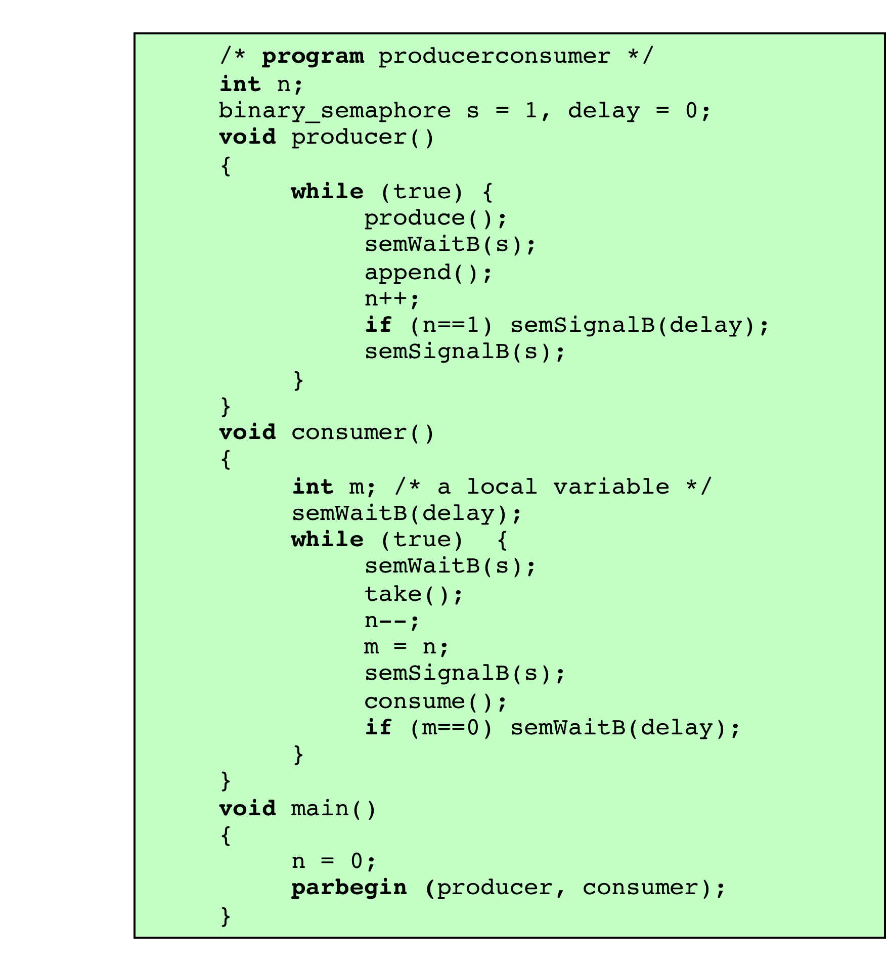
Figure 5.10
A Correct Solution to the Infinite-Buffer Producer/
Consumer Problem Using Binary Semaphores
Notes:
A fix for the problem is to introduce an auxiliary variable that can be set in the consumer’s critical section for use later on. This is shown in Figure 5.10 . A careful trace of the logic should convince you that deadlock can no longer occur.

Slide 20
(Figure 5.11)
General Semaphore
Solution
Notes:
A somewhat cleaner solution can be obtained if general semaphores (also called counting semaphores) are used, as shown in Figure 5.11 . The variable n is now a semaphore. Its value still is equal to the number of items in the buffer. Suppose now that in transcribing this program, a mistake is made and the operations semSignal(s) and semSignal(n) are interchanged. This would require that the semSignal(n) operation be performed in the producer’s critical section without interruption by the consumer or another producer. Would this affect the program? No, because the consumer must wait on both semaphores before proceeding in any case.

Slide 21
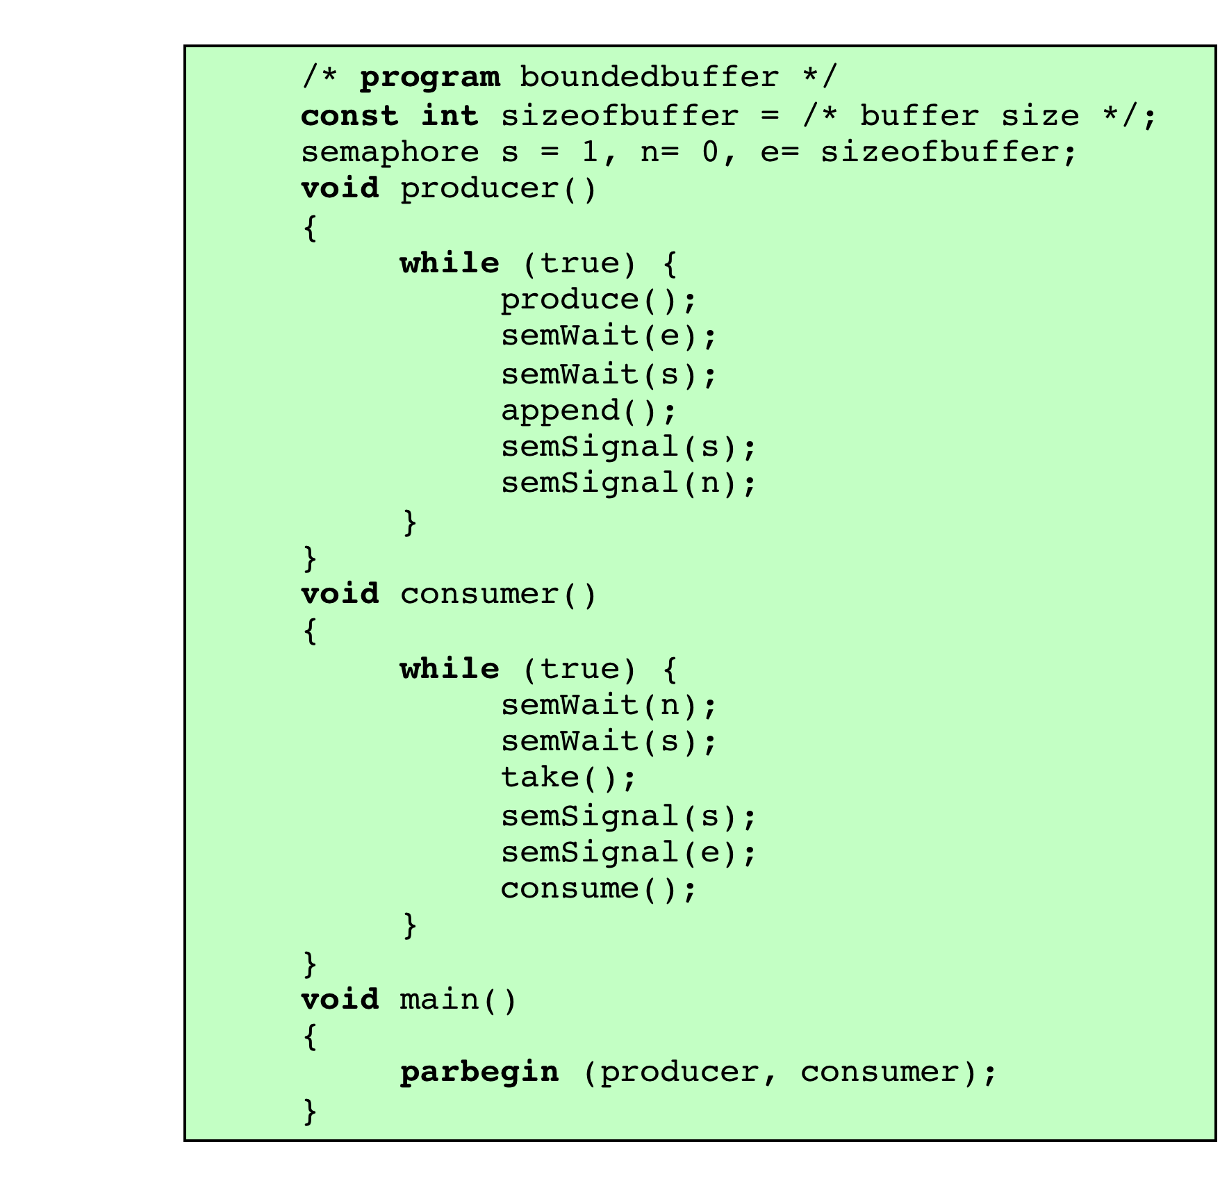
Figure 5.13
Bounded-Buffer Producer/
Consumer
Semaphore
Solution
Notes:
Figure 5.13 shows a solution using general semaphores. The semaphore e has been added to keep track of the number of empty spaces.

Slide 22

Monitors
Theoretical formalization by C. A. R. Hoare
Programming language construct that provides equivalent functionality to that of semaphores
Implemented in a number of programming languages (Concurrent Pascal, Pascal-Plus, Modula-2, Modula-3, and Java – not native in C++)
Software module consists of one or more procedures, an initialization sequence, and local data
Notes:
The monitor is a programming-language construct that provides equivalent functionality to that of semaphores and that is easier to control. The concept was first formally defined in [HOAR74]. The monitor construct has been implemented in a number of programming languages, including Concurrent Pascal, Pascal-Plus, Modula-2, Modula-3, and Java. It has also been implemented as a program library. This allows programmers to put a monitor lock on any object. In particular, for something like a linked list, you may want to lock all linked lists with one lock, or have one lock for each list, or have one lock for each element of each list.
A monitor is a software module consisting of one or more procedures, an initialization sequence, and local data.

Slide 23
Monitor Characteristics
Local data variables are accessible only by the monitor’s procedures and not by any external procedure
Process enters monitor by invoking one of its procedures
Only one process may be executing in the monitor at a time
Notes:
The chief characteristics of a monitor are the following:
1. The local data variables are accessible only by the monitor’s procedures and
not by any external procedure.
2. A process enters the monitor by invoking one of its procedures.
3. Only one process may be executing in the monitor at a time; any other processes
that have invoked the monitor are blocked, waiting for the monitor to become available.
The first two characteristics are reminiscent of those for objects in object-oriented software. Indeed, an object-oriented OS or programming language can readily implement a monitor as an object with special characteristics.
By enforcing the discipline of one process at a time, the monitor is able to provide a mutual exclusion facility. The data variables in the monitor can be accessed by only one process at a time. Thus, a shared data structure can be protected by placing it in a monitor. If the data in a monitor represent some resource, then the monitor provides a mutual exclusion facility for accessing the resource.
To be useful for concurrent processing, the monitor must include synchronization tools. For example, suppose a process invokes the monitor and, while in the
monitor, must be blocked until some condition is satisfied. A facility is needed by which the process is not only blocked but releases the monitor so that some other process may enter it. Later, when the condition is satisfied and the monitor is again available, the process needs to be resumed and allowed to reenter the monitor at the point of its suspension.

Slide 24
cwait (c) – Suspend execution, waiting for condition c
csignal(c) – resume of some blocked process waiting on condition c
What if csignal(c) and nothing was waiting . . . ?
Notes:
Figure 5.15 illustrates the structure of a monitor. Although a process can enter the monitor by invoking any of its procedures, we can think of the monitor as having a single entry point that is guarded so that only one process may be in the monitor at a time. Other processes that attempt to enter the monitor join a queue of processes blocked waiting for monitor availability. Once a process is in the monitor, it may temporarily block itself on condition x by issuing cwait(x) ; it is then placed in a queue of processes waiting to reenter the monitor when the condition changes, and resume execution at the point in its program following the cwait(x) call. If a process that is executing in the monitor detects a change in the condition variable x , it issues csignal(x) , which alerts the corresponding condition queue that the condition has changed.

Slide 25
Monitors (software-like-semaphores)
Hoare (original definition)
MESA Monitors (implementation)
csignal requires a process in the queue to execute immediately
If conditional
Relies on perfect scheduling to execute perfectly
Will break under incorrect signaling conditions
cnotify notifies the queue, but notifying process continues to execute
While conditional
Includes a ‘safety check’ on the conditional prior to resuming execution
Can handle an incorrect notification condition

Slide 26
Monitors (software-like-semaphores)
Hoare
MESA
Statement A
If (condition) {
Statement B }
Statement C
C executes immediately after B
Statement A
While (condition) {
Statement B }
Statement C
Conditional is checked immediately after B; and C executes only when conditional is cleared

Slide 27
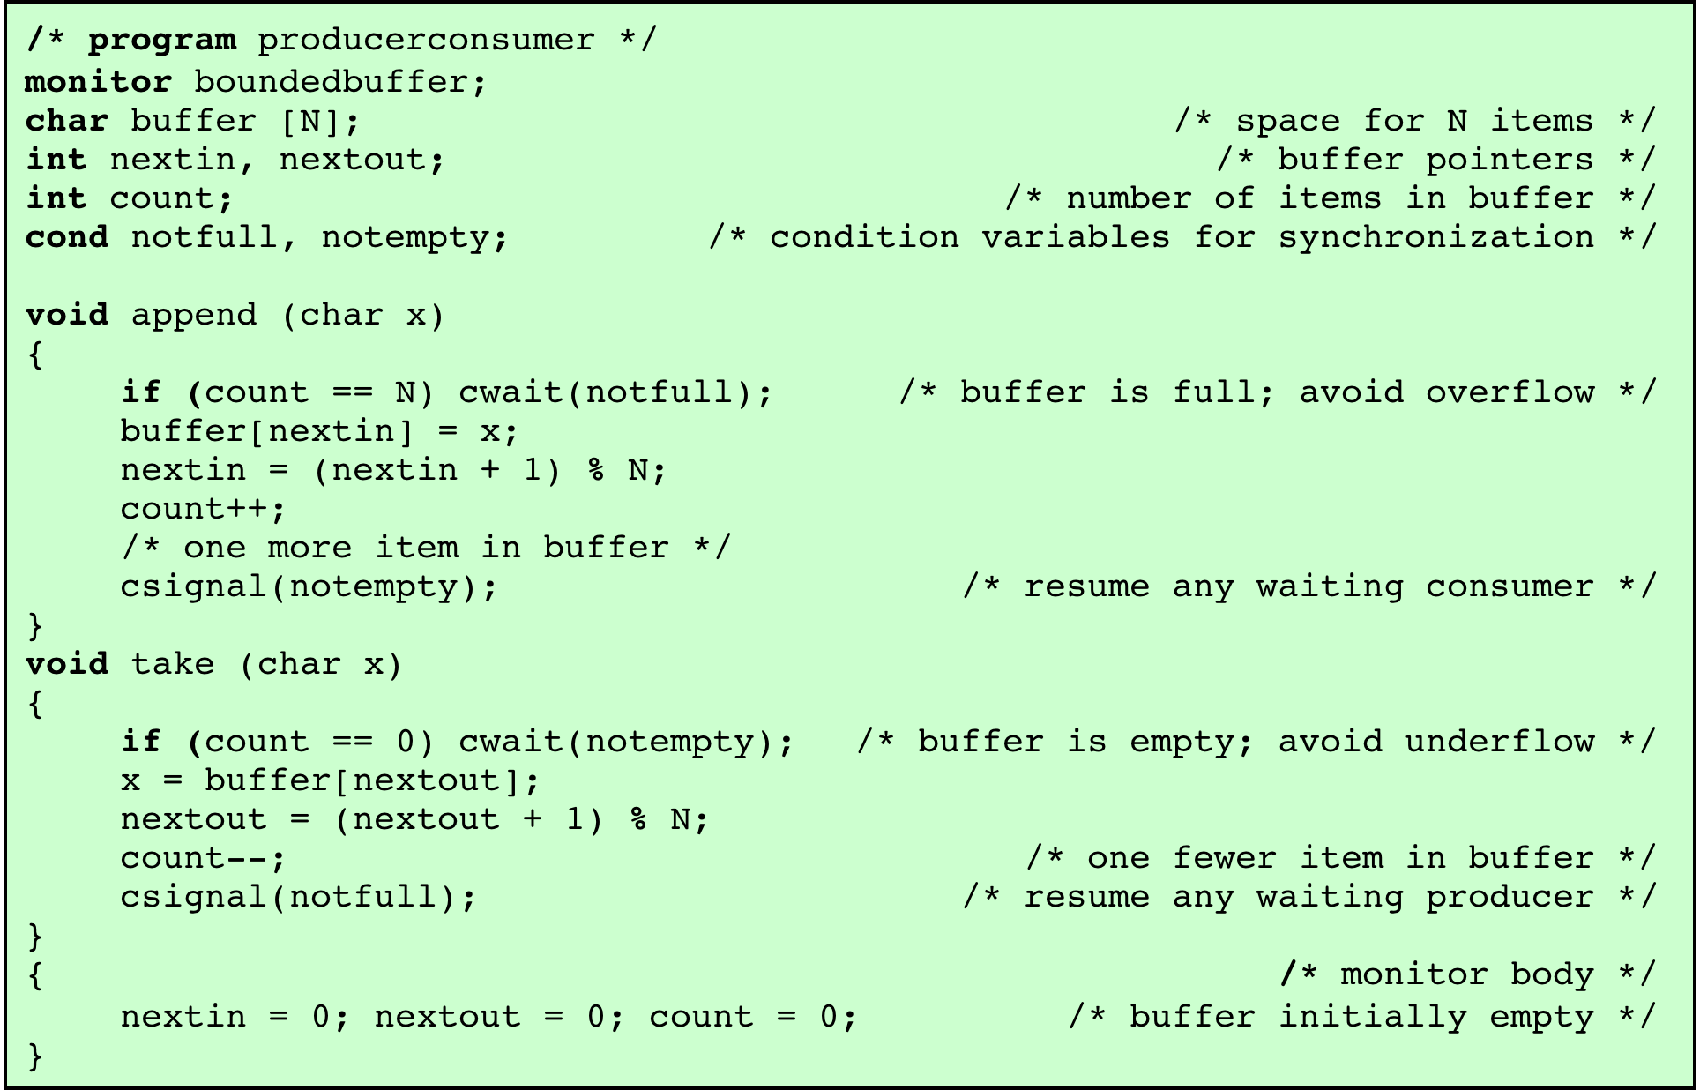
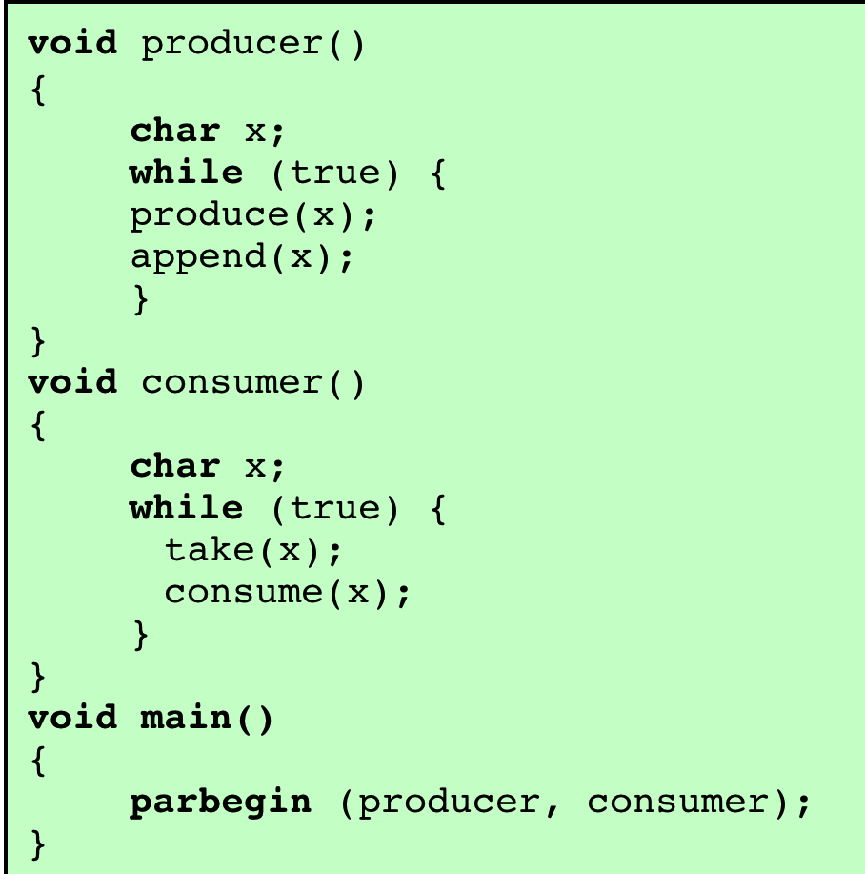
Figure 5.16
A Monitor Solution to the Bounded-Buffer Producer/ Consumer Problem
Notes:
As an example of the use of a monitor, let us return to the bounded-buffer producer/consumer problem. Figure 5.16 shows a solution using a monitor. The monitor module, boundedbuffer , controls the buffer used to store and retrieve characters. The monitor includes two condition variables (declared with the construct cond ): notfull is true when there is room to add at least one character to the buffer, and notempty is true when there is at least one character in the buffer.
A producer can add characters to the buffer only by means of the procedure append inside the monitor; the producer does not have direct access to buffer . The procedure first checks the condition notfull to determine if there is space available in the buffer. If not, the process executing the monitor is blocked on that condition. Some other process (producer or consumer) may now enter the monitor. Later, when the buffer is no longer full, the blocked process may be removed from the queue, reactivated, and resume processing. After placing a character in the buffer, the process signals the notempty condition. A similar description can be made of the consumer function.
This example points out the division of responsibility with monitors compared to semaphores. In the case of monitors, the monitor construct itself enforces mutual exclusion: It is not possible for both a producer and a consumer simultaneously to access the buffer. However, the programmer must place the appropriate cwait and csignal primitives inside the monitor to prevent processes from depositing items in a full buffer or removing them from an empty one. In the case of semaphores, both mutual exclusion and synchronization are the responsibility of the programmer.
Note that in Figure 5.16 , a process exits the monitor immediately after executing the csignal function. If the csignal does not occur at the end of the procedure, then, in Hoare’s proposal, the process issuing the signal is blocked to make the monitor available and placed in a queue until the monitor is free. One possibility at this point would be to place the blocked process in the entrance queue, so that it would have to compete for access with other processes that had not yet entered the monitor. However, because a process blocked on a csignal function has already partially performed its task in the monitor, it makes sense to give this process precedence over newly entering processes by setting up a separate urgent queue ( Figure 5.15 ). One language that uses monitors, Concurrent Pascal, requires that csignal only appear as the last operation executed by a monitor procedure.
If there are no processes waiting on condition x , then the execution of csignal( x ) has no effect.
As with semaphores, it is possible to make mistakes in the synchronization function
of monitors. For example, if either of the csignal functions in the boundedbuffer
monitor are omitted, then processes entering the corresponding condition
queue are permanently hung up. The advantage that monitors have over semaphores
is that all of the synchronization functions are confined to the monitor. Therefore, it
is easier to verify that the synchronization has been done correctly and to detect bugs.
Furthermore, once a monitor is correctly programmed, access to the protected resource
is correct for access from all processes. In contrast, with semaphores, resource access is
correct only if all of the processes that access the resource are programmed correctly.

Slide 28
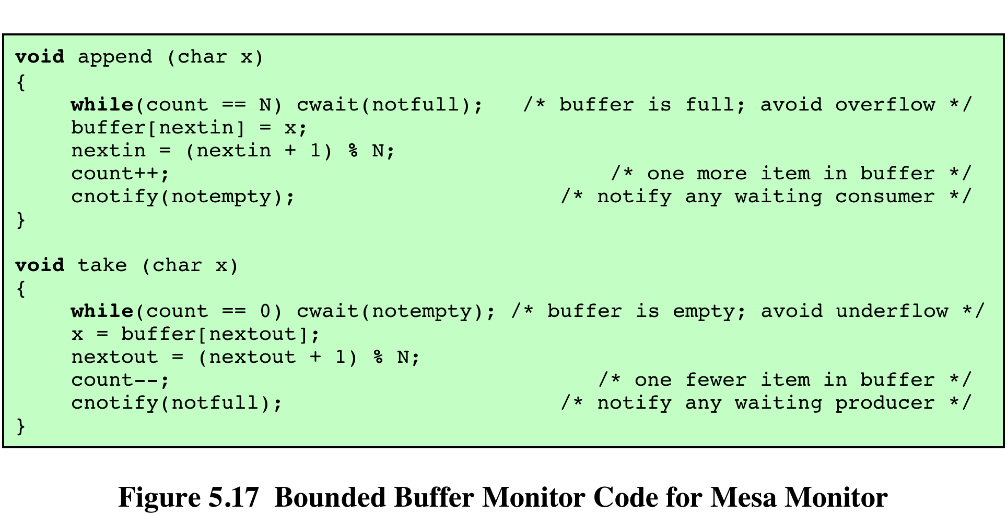
Notes:
Hoare’s definition of monitors [HOAR74] requires that if there is at least one process
in a condition queue, a process from that queue runs immediately when another
process issues a csignal for that condition. Thus, the process issuing the
csignal must either immediately exit the monitor or be blocked on the monitor.
Lampson and Redell developed a different definition of monitors for the
language Mesa [LAMP80]. Their approach overcomes the problems just listed
and supports several useful extensions. The Mesa monitor structure is also used in
the Modula-3 systems programming language [NELS91]. In Mesa, the csignal
primitive is replaced by cnotify , with the following interpretation: When a process
executing in a monitor executes cnotify(x), it causes the x condition queue
to be notified, but the signaling process continues to execute. The result of the notification
is that the process at the head of the condition queue will be resumed at
some convenient future time when the monitor is available. However, because there
is no guarantee that some other process will not enter the monitor before the waiting
process, the waiting process must recheck the condition. For example, the procedures
in the boundedbuffer monitor would now have the code of Figure 5.17.
An advantage of Lampson/Redell monitors over Hoare monitors is that the
Lampson/Redell approach is less prone to error. In the Lampson/Redell approach,
because each procedure checks the monitor variable after being signaled, with the
use of the while construct, a process can signal or broadcast incorrectly without causing
an error in the signaled program. The signaled program will check the relevant
variable and, if the desired condition is not met, continue to wait.
Another advantage of the Lampson/Redell monitor is that it lends itself to a
more modular approach to program construction.

Slide 29
Message Passing
Table 5.5
Design Characteristics of Message Systems for
Interprocess Communication and Synchronization
Notes:
A number of design issues relating to message-passing systems are listed in Table 5.5 , and examined in the remainder of this section.

Slide 30
Direct Addressing
Send primitive includes a specific identifier of the destination process
Receive primitive can be handled in one of two ways:
require that the process explicitly designate a sending process
effective for cooperating concurrent processes
implicit addressing
source parameter of the receive primitive possesses a value returned when the receive operation has been performed
Notes:
With direct addressing , the send primitive includes a specific identifier of the destination process. The receive primitive can be handled in one of two ways. One possibility is to require that the process explicitly designate a sending process. Thus, the process must know ahead of time from which process a message is expected. This will often be effective for cooperating concurrent processes. In other cases, however, it is impossible to specify the anticipated source process. An example is a printer server process, which will accept a print request message from any other process. For such applications, a more effective approach is the use of implicit addressing. In this case, the source parameter of the receive primitive possesses a value returned when the receive operation has been performed.

Slide 31
Indirect Addressing
Messages are sent to a shared data structure consisting of queues that can temporarily hold messages
Queues are referred to as mailboxes
One process sends a message to the mailbox and the other process picks up the message from the mailbox
Allows for greater flexibility in the use of messages
Notes:
The other general approach is indirect addressing . In this case, messages are not sent directly from sender to receiver but rather are sent to a shared data structure consisting of queues that can temporarily hold messages. Such queues are generally referred to as mailboxes . Thus, for two processes to communicate, one process sends a message to the appropriate mailbox and the other process picks up the message from the mailbox.
A strength of the use of indirect addressing is that, by decoupling the sender and receiver, it allows for greater flexibility in the use of messages.

Slide 32
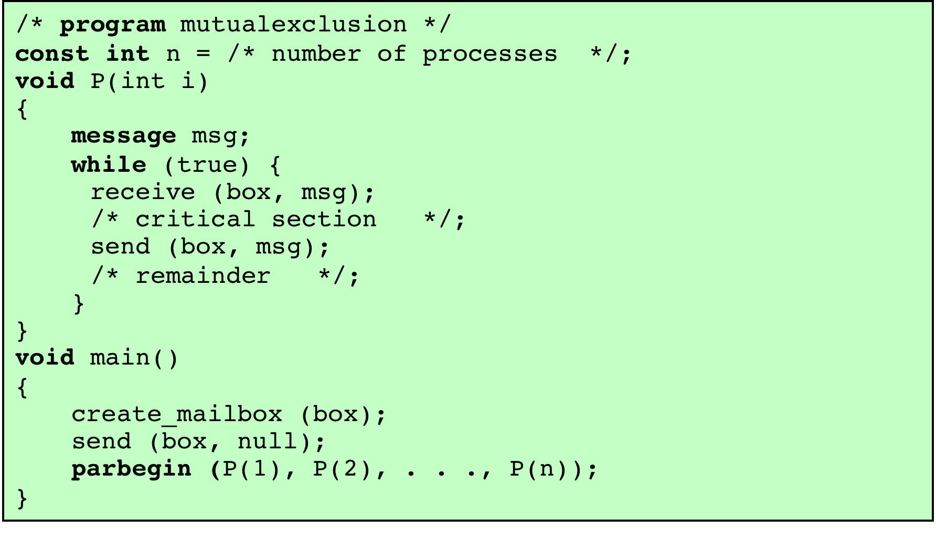
Figure 5.20
Mutual Exclusion Using Messages
Notes:
Figure 5.20 shows one way in which message passing can be used to enforce mutual exclusion (compare Figures 5.1 , 5.2 , and 5.6 ). We assume the use of the blocking receive primitive and the nonblocking send primitive. A set of concurrent processes share a mailbox, box , which can be used by all processes to send and receive.
The mailbox is initialized to contain a single message with null content. A process wishing to enter its critical section first attempts to receive a message. If the mailbox is empty, then the process is blocked. Once a process has acquired the message, it performs its critical section and then places the message back into the mailbox. Thus, the message functions as a token that is passed from process to process.
The preceding solution assumes that if more than one process performs the receive operation concurrently, then:
• If there is a message, it is delivered to only one process and the others are
blocked, or
• If the message queue is empty, all processes are blocked; when a message is
available, only one blocked process is activated and given the message.
These assumptions are true of virtually all message-passing facilities.

Slide 33
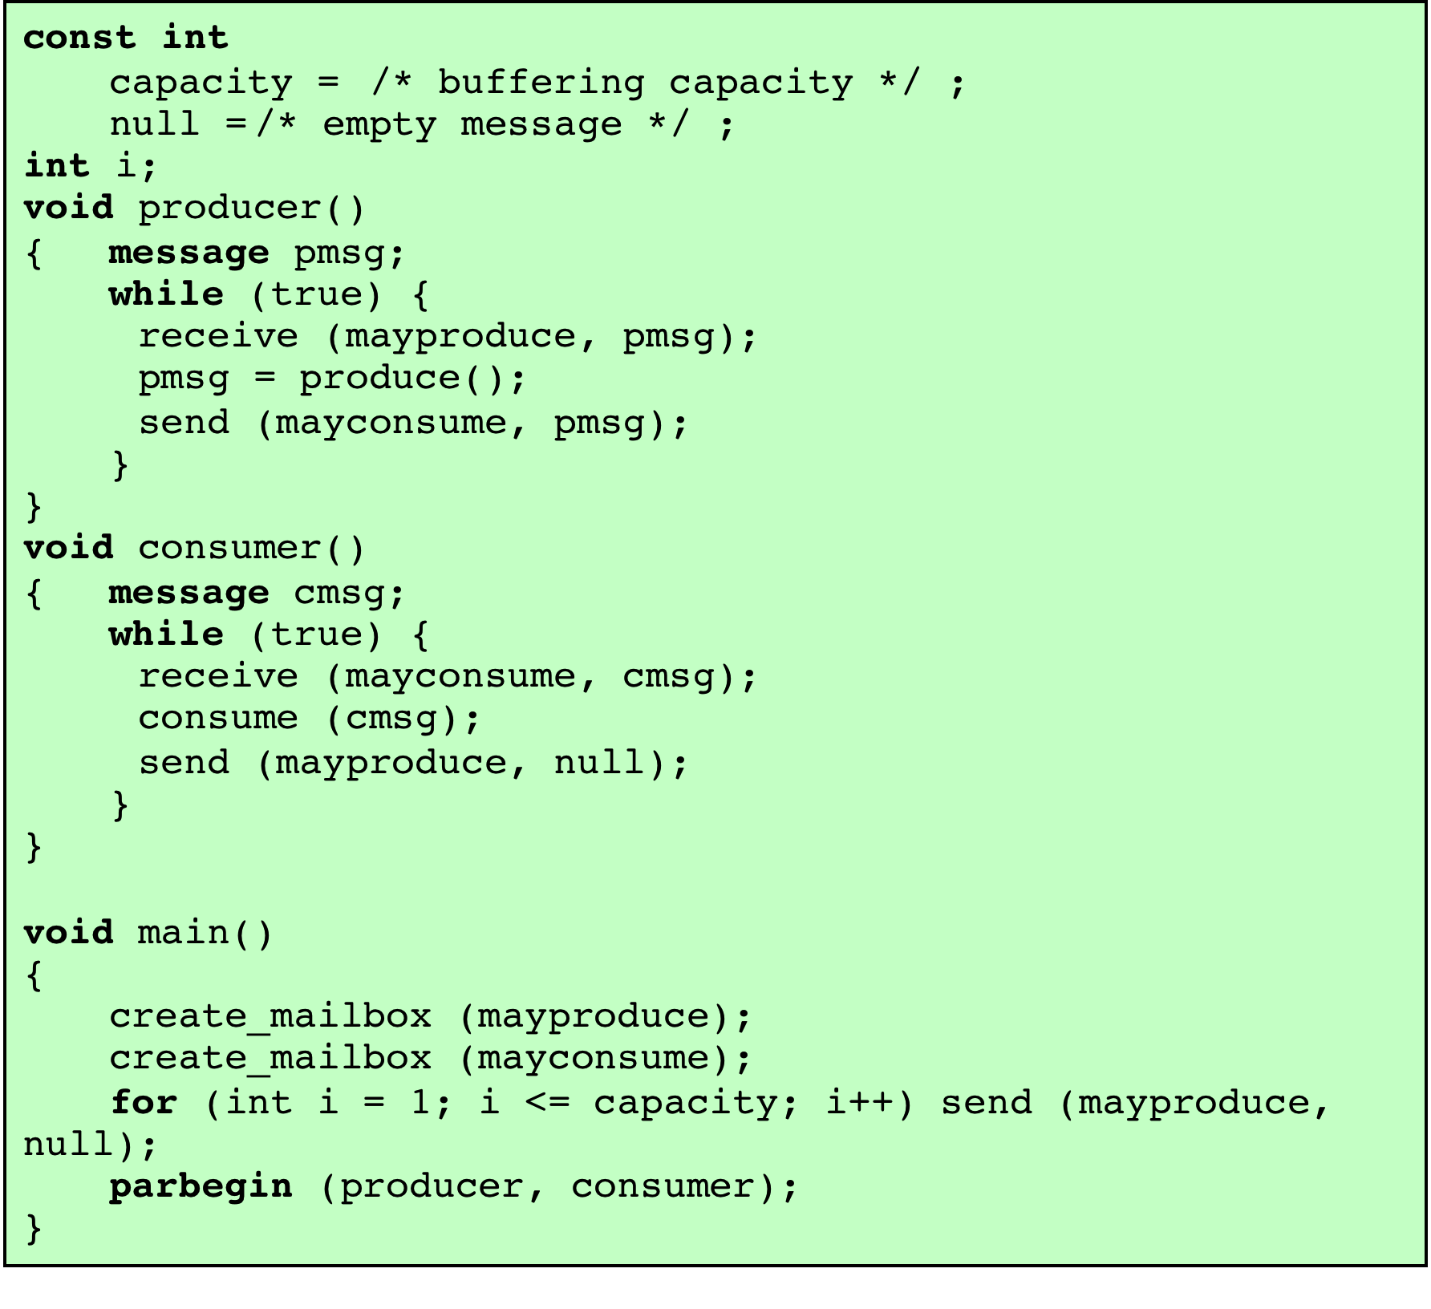
Figure 5.21
A Solution to the Bounded-Buffer Producer/
Consumer Problem Using Messages
Notes:
As an example of the use of message passing, Figure 5.21 is a solution to the bounded-buffer producer/consumer problem. Using the basic mutual-exclusion power of message passing, the problem could have been solved with an algorithmic structure similar to that of Figure 5.13 . Instead, the program of Figure 5.21 takes advantage of the ability of message passing to be used to pass data in addition to signals. Two mailboxes are used. As the producer generates data, it is sent as messages to the mailbox mayconsume . As long as there is at least one message in that mailbox, the consumer can consume. Hence mayconsume serves as the buffer; the data in the buffer are organized as a queue of messages. The “size” of the buffer is
determined by the global variable capacity . Initially, the mailbox mayproduce is filled with a number of null messages equal to the capacity of the buffer. The number of messages in mayproduce shrinks with each production and grows with each consumption. This approach is quite flexible. There may be multiple producers and consumers, as long as all have access to both mailboxes. The system may even be distributed, with all producer processes and the mayproduce mailbox at one site and all the consumer processes and the mayconsume mailbox at another.

Slide 34
Is this P/C thread safe for multiple consumers?
Yes
No
Not sure
Notes:
P224 (8th)

Slide 35
Is this P/C thread safe for multiple consumers?
Yes
No
Not sure
Notes:
P225 (8th)

Slide 36
Thread-safe P/C model
First semWait ensures the P/C can perform that operation
Second semWait protects the critical section
When Signals are sent, the space/dumplings are available

Slide 37
NOT thread-safe for multiple consumers
2 dumplings available
Con1 takes a dumping
M = 1
Busy eating
Con2 takes a dumpling
M = 0
Busy eating
Con1 finishes eating
M != 0 so we don’t wait
Con1 attempts to eat nonexistent dumpling!

Slide 38
P/C Binary Semaphore Solution
int n;
binary_semaphore AccessToPlate=1, MoreDonutsAvailable=0;
void producer() {
while (true) {
cookDounut();
semWaitB(AccessToPlate);
PutDonutOnPlate();
n++;
if (n == 1) semSignalB(MoreDonutsAvailable); //Fresh plate of donuts ready
semSignalB(AccessToPlate); } }
void consumer() {
while (true) {
semWaitB(MoreDonutsAvailable);
semWaitB(AccessToPlate);
GrabDonutFromPlate();
n--;
if (n > 0) semSignalB(MoreDonutsAvailable); //tell everybody there's still more
semSignalB(AccessToPlate);
EatDonut(); } }
Notes:
This is a correct implementation of a binary semaphore for the unbounded buffer producer/consumer (i.e., the producer doesn’t have to worry about filling up a buffer – we only need to worry about the consumer needing to account for no donuts).

Slide 39
Readers/Writers Problem
A data area is shared among many processes
some processes only read the data area, (readers) and some only write to the data area (writers)
Conditions that must be satisfied:
any number of readers may simultaneously read the file
only one writer at a time may write to the file
if a writer is writing to the file, no reader may read it
Notes:
The readers/writers problem is defined as follows: There is a data area shared among a number of processes. The data area could be a file, a block of main memory, or even a bank of processor registers. There are a number of processes that only read the data area (readers) and a number that only write to the data area (writers). The conditions that must be satisfied are as follows:
1. Any number of readers may simultaneously read the file.
2. Only one writer at a time may write to the file.
3. If a writer is writing to the file, no reader may read it.
Thus, readers are processes that are not required to exclude one another and writers are processes that are required to exclude all other processes, readers and writers alike.

Slide 40
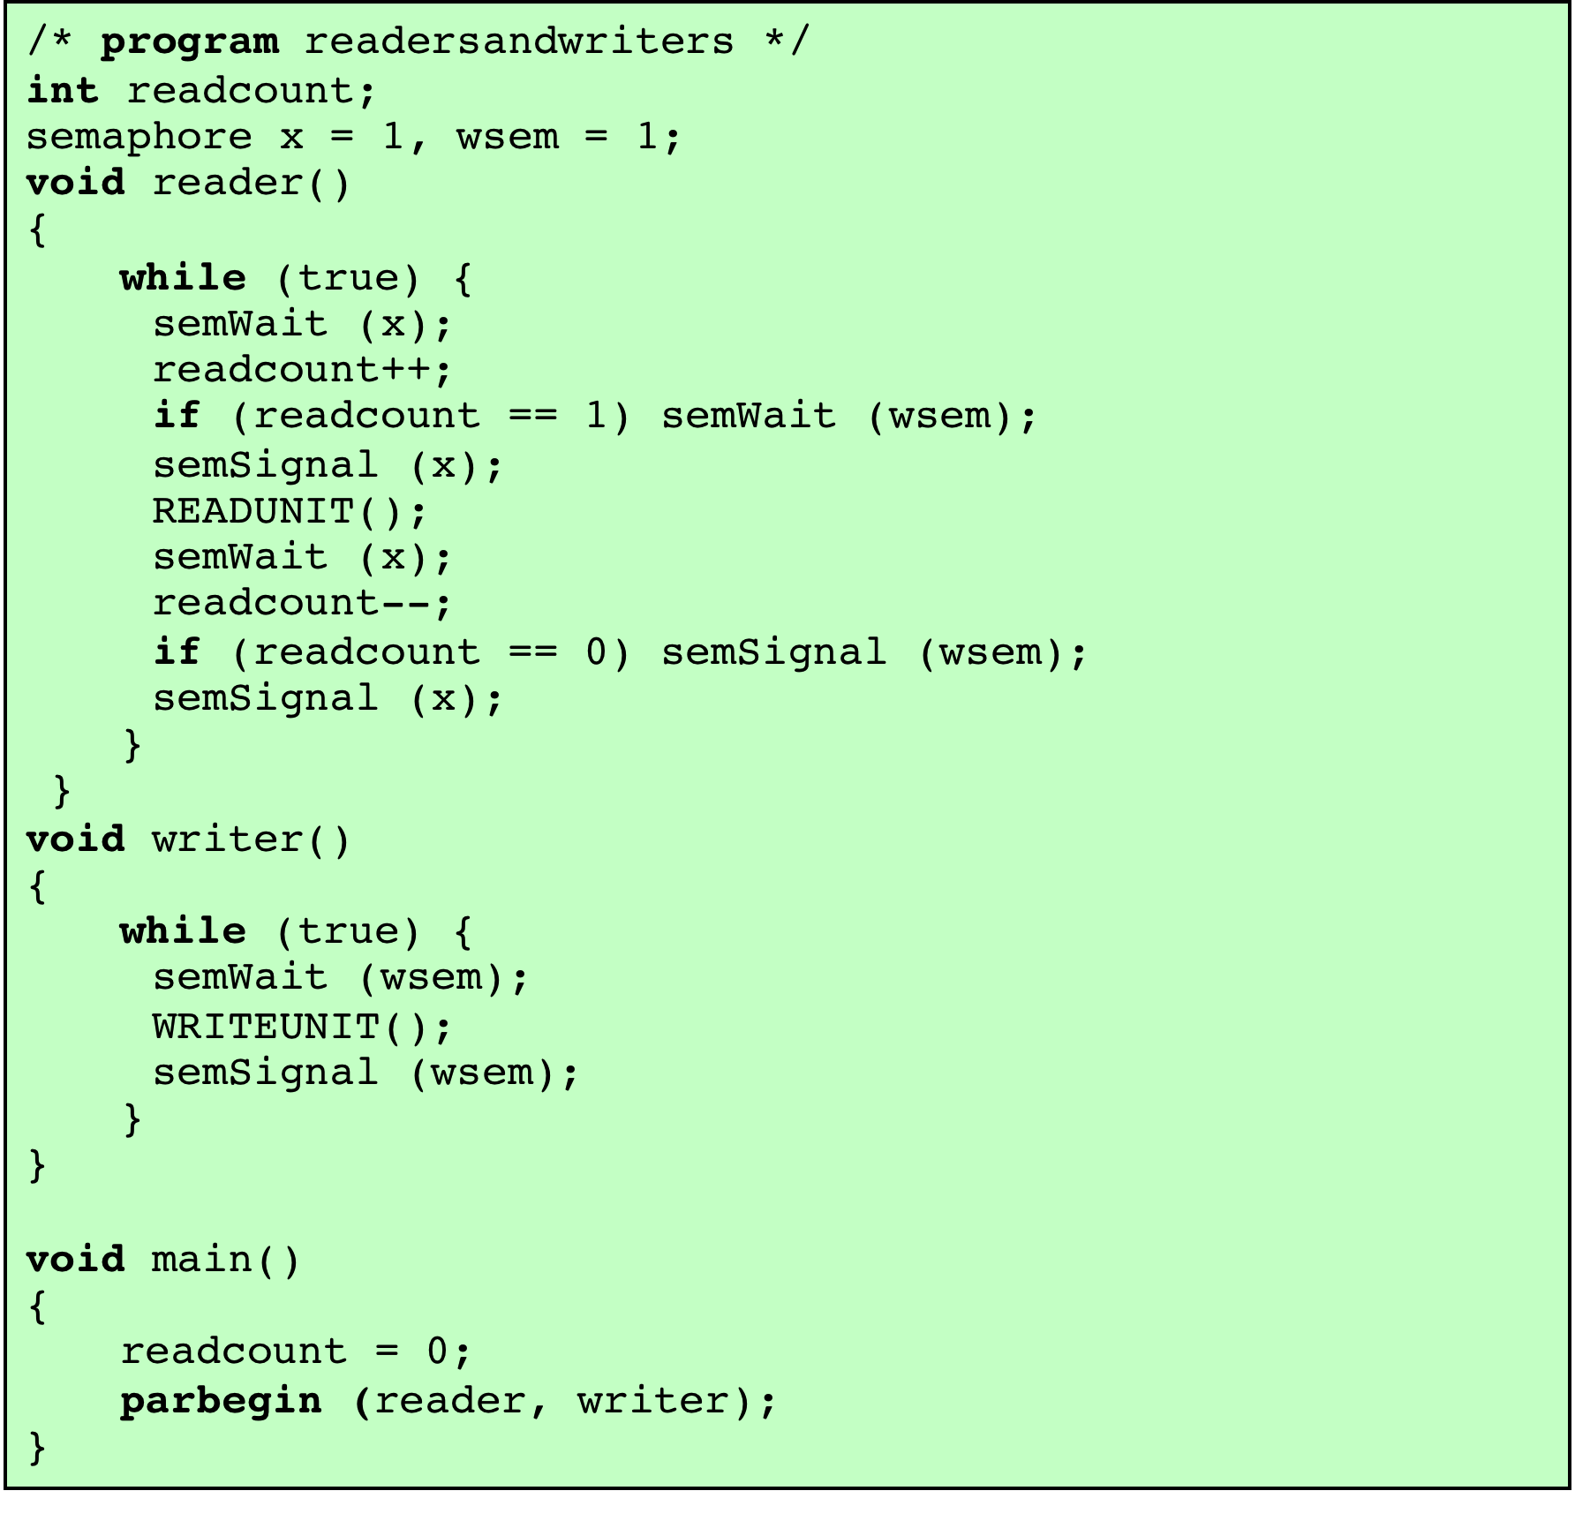
Figure 5.22
A Solution to the Readers/
Writers Problem Using Semaphores
Who Has Priority ?
Notes:
Figure 5.22 is a solution using semaphores, showing one instance each of a reader and a writer; the solution does not change for multiple readers and writers. The writer process is simple. The semaphore wsem is used to enforce mutual exclusion. As long as one writer is accessing the shared data area, no other writers and no readers may access it. The reader process also makes use of wsem to enforce mutual exclusion. However, to allow multiple readers, we require that, when there are no readers reading, the first reader that attempts to read should wait on wsem . When there is already at least one reader reading, subsequent readers need not wait before entering. The global variable readcount is used to keep track of the number of readers, and the semaphore x is used to assure that readcount is updated properly.

Slide 41
Dining Philosophers Problem
Philosophers lives consist of thinking and eating
Constraints
No two philosophers can use the same fork at the same time (mutual exclusion)
No philosopher must starve to death (avoid deadlock and starvation)
Notes:
We now turn to the dining philosophers problem, introduced by Dijkstra [DIJK71]. Five philosophers live in a house, where a table is laid for them. The life of each philosopher consists principally of thinking and eating, and through years of thought, all of the philosophers had agreed that the only food that contributed to their thinking efforts was spaghetti. Due to a lack of manual skill, each philosopher requires two forks to eat spaghetti.
The eating arrangements are simple ( Figure 6.11 ): a round table on which is set a large serving bowl of spaghetti, five plates, one for each philosopher, and five forks. A philosopher wishing to eat goes to his or her assigned place at the table and, using the two forks on either side of the plate, takes and eats some spaghetti. The problem: Devise a ritual (algorithm) that will allow the philosophers to eat. The algorithm must satisfy mutual exclusion (no two philosophers can use the same fork at the same time) while avoiding deadlock and starvation (in this case, the term has literal as well as algorithmic meaning!).
This problem may not seem important or relevant in itself. However, it does illustrate basic problems in deadlock and starvation. Furthermore, attempts to develop solutions reveal many of the difficulties in concurrent programming (e.g., see [GING90]). In addition, the dining philosophers problem can be seen as representative of problems dealing with the coordination of shared resources, which may occur when an application includes concurrent threads of execution. Accordingly, this problem is a standard test case for evaluating approaches to synchronization.

Slide 42
Figure 6.12 A First Solution to the Dining Philosophers Problem
Notes:
Figure 6.12 suggests a solution using semaphores. Each philosopher picks up first the fork on the left and then the fork on the right. After the philosopher is finished eating, the two forks are replaced on the table. This solution, alas, leads to deadlock: If all of the philosophers are hungry at the same time, they all sit down, they all pick up the fork on their left, and they all reach out for the other fork, which is not there. In this undignified position, all philosophers starve.
To overcome the risk of deadlock, we could buy five additional forks (a more sanitary solution!) or teach the philosophers to eat spaghetti with just one fork. As another approach, we could consider adding an attendant who only allows four philosophers at a time into the dining room. With at most four seated philosophers, at least one philosopher will have access to two forks.

Slide 43
Dining philosopher solutions
Numbered forks, if both available, secure the lowest numbered first
Utilize an arbitrator to ensure only one eating at a time
Relax the problem to allow message passing…

Slide 44
Chandy/Misra message passing dining philosophers solution
For every pair of philosophers contending for a resource, create a fork and give it to the philosopher with the lower ID (n for agent P_{n}). Each fork can either be dirty or clean. Initially, all forks are dirty.
When a philosopher wants to use a set of resources (i.e. eat), he must obtain the forks from his contending neighbors. For all such forks he does not have, he sends a request message.
When a philosopher with a fork receives a request message, he keeps the fork if it is clean, but gives it up when it is dirty. If he sends the fork over, he cleans the fork before doing so.
After a philosopher is done eating, all his forks become dirty. If another philosopher had previously requested one of the forks, he cleans the fork and sends it.

